Slide 1

Project- NYC TAXI TRIP DURATION PREDICTION
By: Shivam Dangi, Vellore Institute of Technology

Slide 2

Project Description
Building a model that predicts the total ride duration of taxi trips in New York City.
Aim is to preprocess, visualize and design a model best suited for the task.
The dataset used is one released by NYC Taxi and Limousine Commission, which includes features like geo-coordinates, passenger count, date and timings, etc.

Slide 3
INTRODUCTION
This project predicts the trip duration of the NYC Taxi with the training done on dataset provided for train and test. This project compares the Linear Regression module and AdaBoostRegressor module for the similar purpose.
Dataset Resource:
Train:
https://drive.google.com/file/d/1__eB5gUp7Ap3CHPzsn75kYRgAHmf8XqY/view
Test:
https://drive.google.com/file/d/1GcrhqniKObyqeTJMxKabld0CSGmZ2o92/view

Slide 4
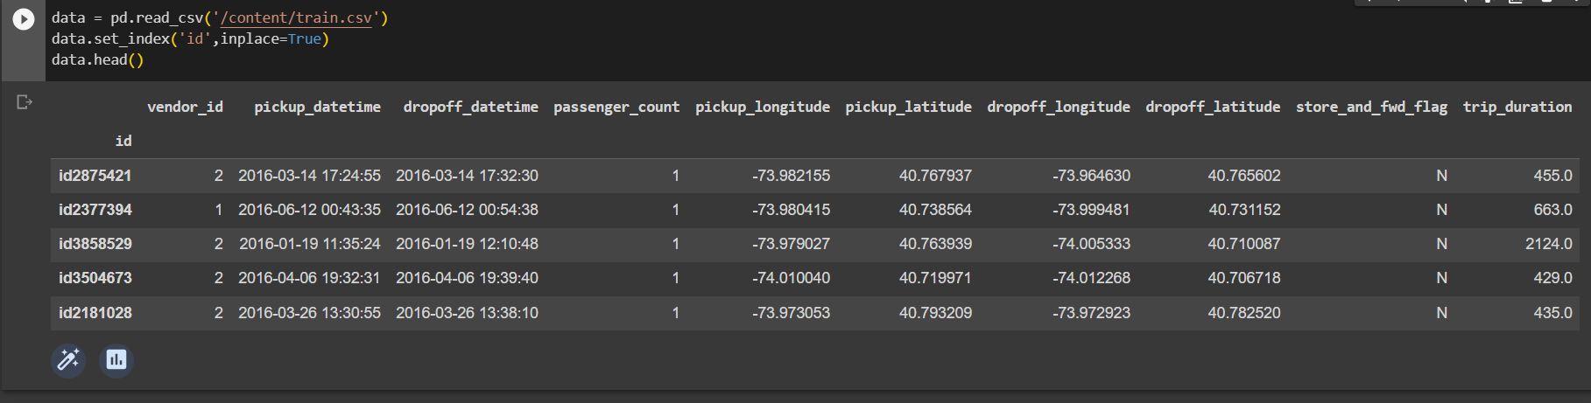
DATA EXPLORATION
Under data exploration, the study of features is very important. It is necessary to categorize
Which features are more significant and may have greater impact. This involve handling the
Missing values in the dataset and others.

Slide 5
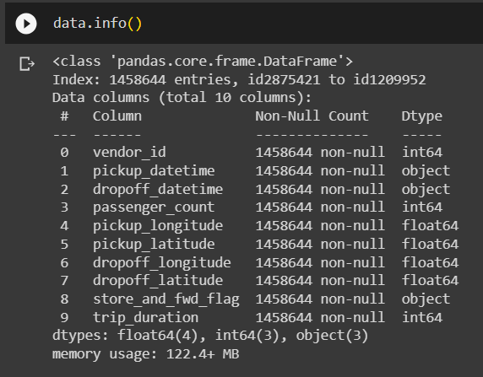
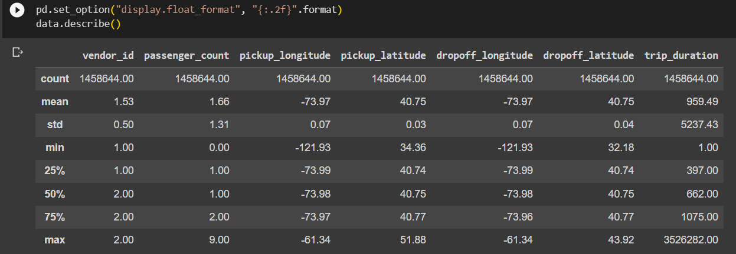
DATA EXPLORATION Cont-
One should ensure the availability of non null values and handle
accordingly. For this project I ensure the format specifier using
set_option() feature of pandas library.

Slide 6
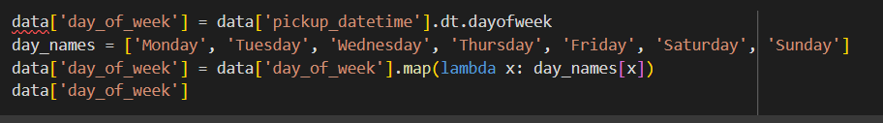
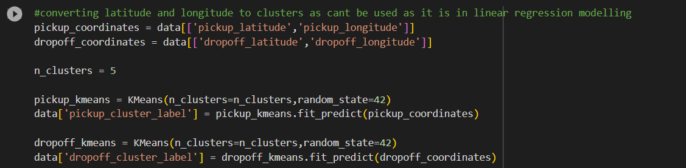
DATA PREPROCESSING
Data Preprocessing is done to handle the missing values in the dataset, to ensure the type of feature required for modelling, whether a numerical or a categorical feature and manipulating the data according to need without impacting the content of the data to noticeable extent.

Slide 7
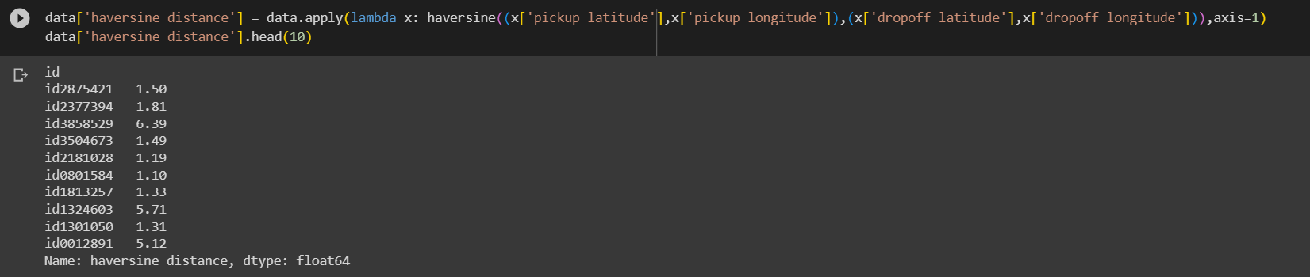
DATA PREPROCESSING Cont.
We have preprocessed the data by modifying the columns to numerical data type as per
the requirements of training models and also added the necessary columns like calculating
distance between the latitudes and longitudes in order to increase learning rate with more
clear and absolute learning feature.

Slide 8
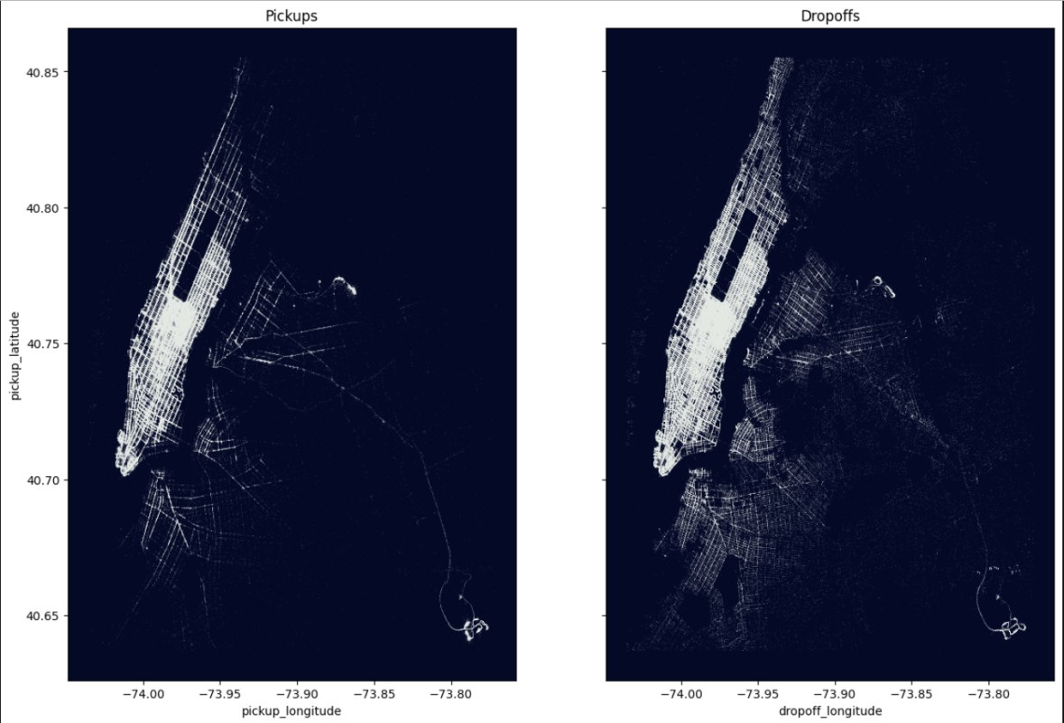
DATA VISUALIZATION
Under this category, we will visualize the data with various comparisons required to understand the data more clearly.
Visualizing pickup and drop-off location of the passengers

Slide 9
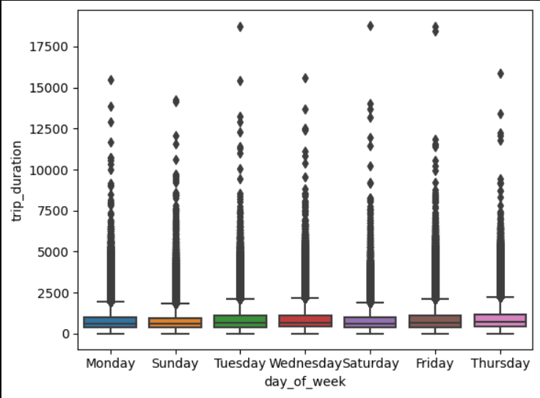
DATA VISUALIZATION Cont.
Relation between the trip duration
and the day of the week
to understand on which day of
the week there was more trip
duration.

Slide 10
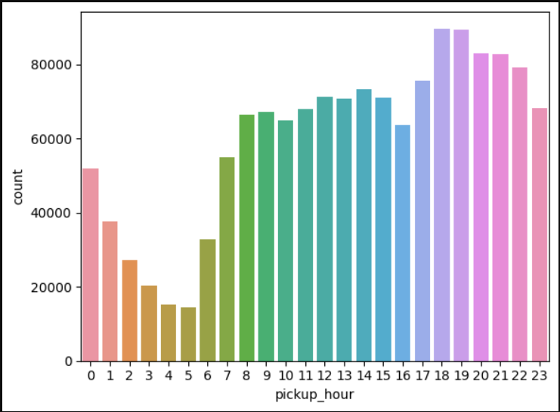
DATA VISUALIZATION Cont.
Visualizing at which hour of the day
there was most pickups are done
i.e. busiest hour of the day
with more taxi requests.

Slide 11
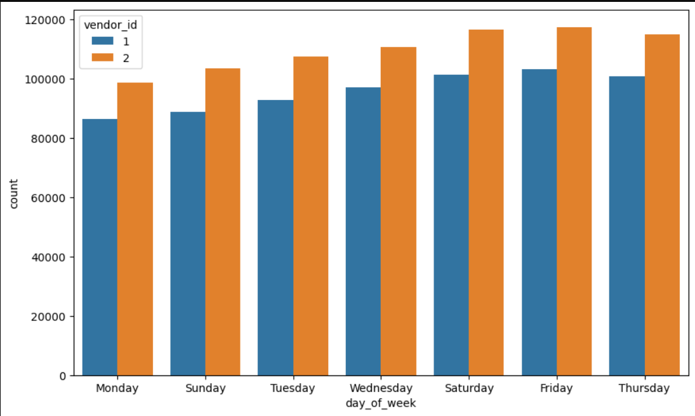
DATA VISUALIZATION Cont.
A graph to analyze which
vendor had how much taxi
requests at every day of
the week.

Slide 12
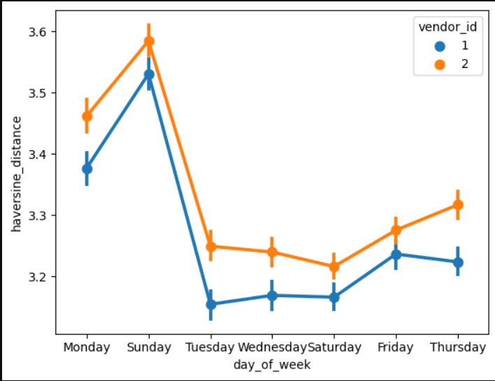
DATA VISUALISATION Cont.
A pointplot diagram to visualize
and observe the relation between
haversine distance, the distance between
two points based on their latitudes and
longitudes and day of the week

Slide 13
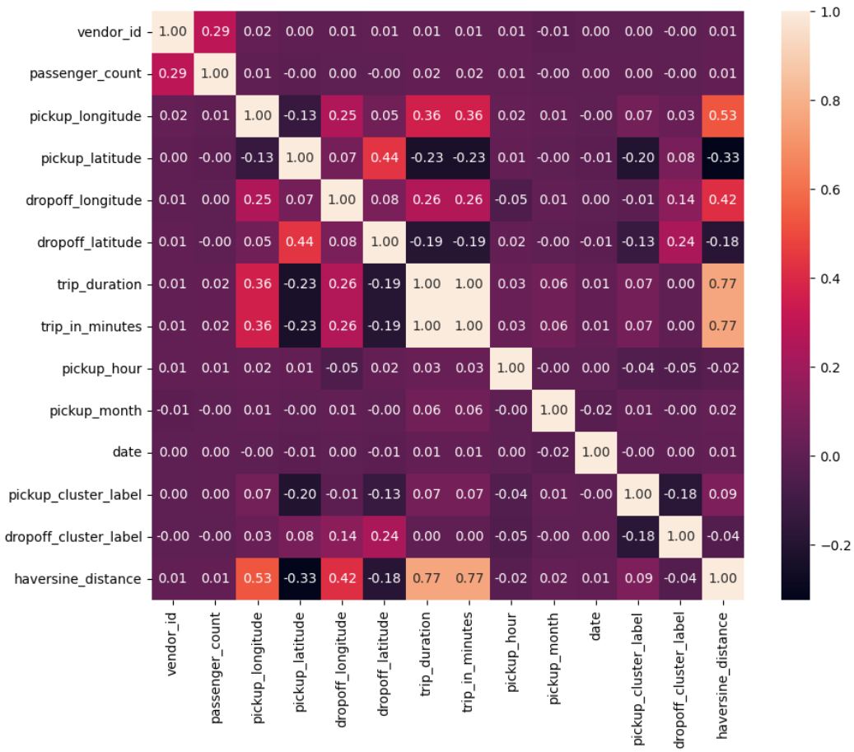
DATA VISUALIZATION Cont.
The analytics of
dataset using a Heat Map

Slide 14
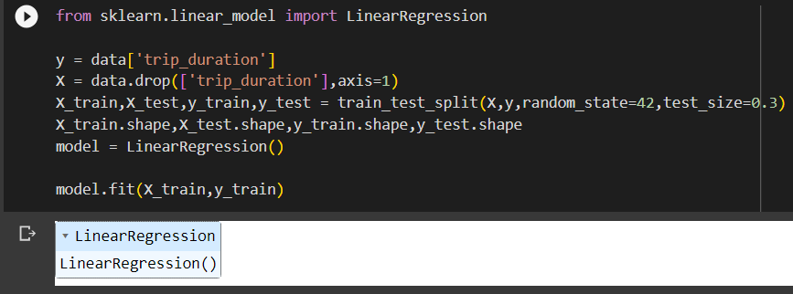
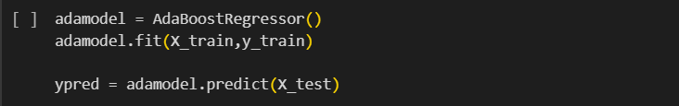
DATA MODELLING
Linear Regression based Modelling
AdaBoostRegressor based Modelling

Slide 15
OBSERVATION- Model Evaluation
The model based on linear regression have root mean square error value of 402 and AdaBoostRegressor have root mean square error count of 515.
We can conclude from this data that linear regression model is more efficient in estimating the trip duration of the train and test dataset.

Slide 16
MODEL SOURCE CODE
Link to GITHUB repository of the project:
https://github.com/shivamdangi/Capabl_Internship_Project.git
Thank You.

